Slide 1
PIN: Less is More for RDMA Load Balancing
Jichun Wu¹, Ran Shu², Yongqiang Xiong², Andrew W. Moore¹
¹ University of Cambridge, ² Microsoft Research
Notes:
Good morning, everyone. I’m Jichun Wu from the University of Cambridge.
Today, I will present PIN, a simple idea for improving RDMA load balancing.
(This work was done with Ran Shu, Yongqiang Xiong, and Andrew Moore.)

Slide 2
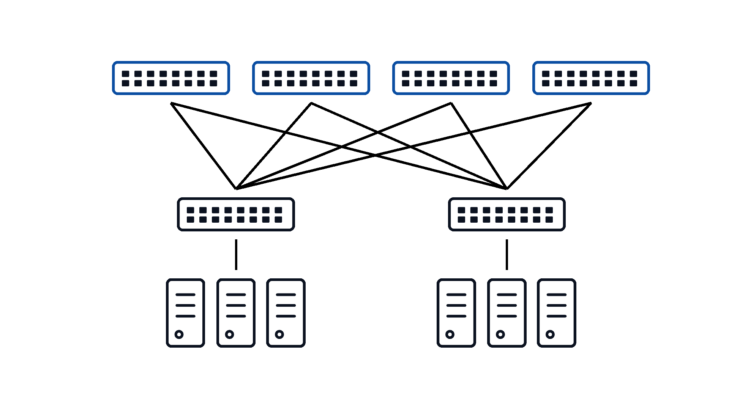
Multi-pathing
Clos network
  High bandwidth provided by
  multiple paths
Equal Cost Multi-Path (ECMP)
  Each flow / connection takes one path based on hash
  Hash collisions cause contention
Notes:
Let me first give some background on multipathing.
Modern datacentres commonly use Clos topologies, where a source and destination are connected by several equal-cost paths. This path diversity provides high aggregate bandwidth.
The standard way to use these paths is Equal-Cost Multi-Path, or ECMP. ECMP hashes each flow, or connection, onto one path and keeps it there. This is simple and preserves packet ordering.
However, different flows can hash onto the same path, even when other paths are underutilised. These hash collisions create persistent contention and can significantly hurt performance.

Slide 3
Spraying is attractive for RDMA
Why spraying?
  Avoid ECMP hash collisions
  Exploit path diversity for large flows
Why now?
  Newer RDMA tolerate reordering
Notes:
This is why packet spraying is attractive.
Instead of assigning an entire flow to one path, spraying distributes its packets across multiple paths. This avoids persistent ECMP collisions and allows large flows to exploit the bandwidth available across the whole fabric.
Historically, packet reordering made this difficult for RDMA. However, newer RDMA designs increasingly tolerate out-of-order delivery, so fine-grained multipathing is becoming much more practical.
The usual intuition is therefore that spraying should improve load balancing. But when we looked at completion time by flow size, we found that this benefit is not uniform.

Slide 4
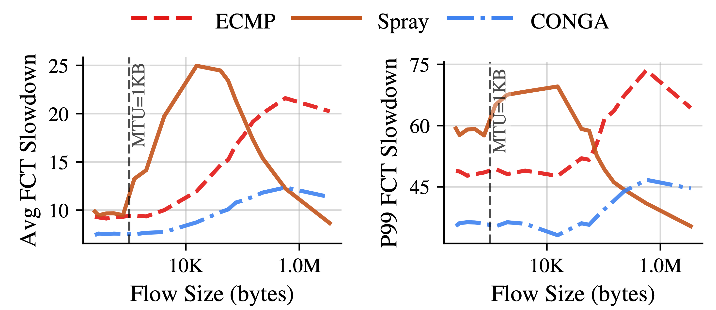
Observation
Spraying does not benefit every flow
Large flows benefit the most
Short flows even worse than ECMP
Better
Notes:
This figure shows the observation that motivated PIN.
The x-axis is flow size, and the y-axis is flow completion time slowdown, so lower is better. The left plot shows average slowdown, and the right plot shows the ninety-ninth percentile.
For large flows, spraying performs well, as expected. But in the highlighted middle region, spraying is actually worse than ECMP. These are short multi-packet flows, larger than one MTU but still relatively small.
So spraying does not benefit every flow. Large flows gain the most from path diversity, while short multi-packet flows can be harmed by it.
Why does this happen?

Slide 5
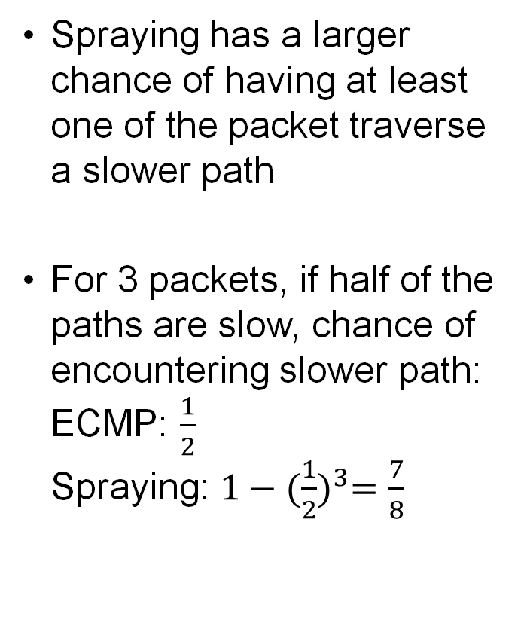
Our hypothesis
ECMP
Spraying has a larger chance of having at least one of the packet traverse a slower path
For 3 packets, if half of the paths are slow, chance of encountering slower path:
ECMP: $\frac{1}{2}$
Spraying: $1−{(\frac{1}{2})}^{3}=\frac{7}{8}$
Packet 1
Packet 2
Normal path
Source
Destination
Packet 3
Spraying
Packet 1
Slow path
Packet 2
Normal path
Source
Destination
Packet 3
Normal path
Notes:
Our hypothesis is that spraying increases the chance that at least one packet encounters a slower path.
Consider this simple example. A short flow contains three packets, and at this moment, half of the available paths are slow. We can ignore the transmission delay here, so the flow latency is roughly the slowest packet’s latency.
With ECMP, the whole flow selects one path. Therefore, the probability of stepping on a slow path is one half.
With spraying, each packet can select a different path. The probability of all packet choosing a normal path is one half cubed, or one eighth. So, the probability that at least one packet stepping on a slow path is seven eighths.
Because completion time is determined by the last arriving packet, one unlucky packet can delay the entire flow. This effect is especially important for short flows, whose transmission delay is very short compared to this path delay (normally queueing delay).

Slide 6
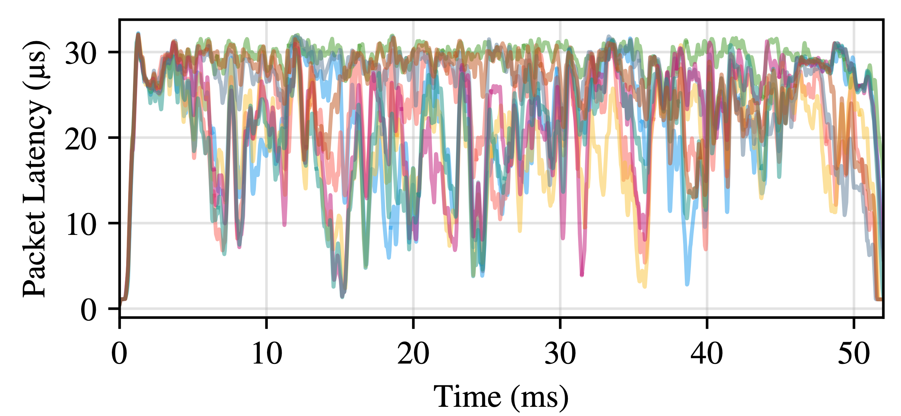
Path quality varies
Spraying with 128 hosts connected by leaf-spine network
Even healthy network experience link quality variation
Notes:
This explanation depends on paths having different path latency, so we checked whether this actually happens.
This graph shows packet latency across the equal-cost paths in a 128-host leaf-spine simulation under spraying. Each line represents one path.
The network is healthy. There are no failed links and no intentionally degraded paths. However, random traffic placement still creates substantial short-term variation in queueing and latency.
At the same moment, latency can differ by tens of microseconds across the available paths. Spraying makes a short flow sample several of these path conditions, increasing the chance that one packet becomes a straggler.
This gives us the key design principle: large flows need path diversity, but short flows need path stability.
TODO: say this is the context, we cannot make it better at this point, but we are lowering the impact

Slide 7
PIN
s ≤ T, use ECMP
RDMA operation
size s
Check against threshold T
Different QoS or flow label
s > T, use baseline
Baseline: Spray, DRILL, REPS
Large flows keep path diversity
Small flows get stability
Notes:
Based on that principle, we propose PIN.
PIN is not a new load-balancing algorithm. It is a lightweight wrapper around an existing fine-grained load balancer, such as Spray, DRILL, or REPS.
For each RDMA operation, we compare its size, $s$, with a threshold, $T$. If the operation is no larger than the threshold, we pin it to one path for its lifetime. In our evaluation, the pinned mode uses simple ECMP-style path selection.
If the operation is larger than the threshold, it continues to use the original baseline load balancer.
This gives short flows stable path conditions, while preserving path diversity for the large flows that contribute most of the bytes.
The mechanism can be implemented using a flow label, an entropy field, or a separate forwarding class. The only new parameter is the size threshold.
TODO: say RDMA declares operation size

Slide 8
Evaluation
Simulator: ns-3
Topology: 128-host leaf-spine, 100Gbps
Workload: Alibaba Storage, Meta Hadoop
Modified to allow reordering
Notes:
We evaluate PIN using packet-level simulation in ns-3.
The topology contains 128 hosts connected through a leaf-spine fabric, with 100-gigabit-per-second links. We modify the receiver model to tolerate packet reordering, which allows us to evaluate fine-grained RDMA multipathing.
We use realistic flow-size distributions, including Alibaba Cloud Storage and Meta Hadoop.
We use three different fine-grained baselines: Spray, DRILL, and REPS. We also include ECMP and CONGA as reference schemes.
We evaluate both average and ninety-ninth-percentile flow completion time slowdown, at fifty and eighty percent offered load.
TODO: trace-driven, specify flow size range, add icons for workload

Slide 9
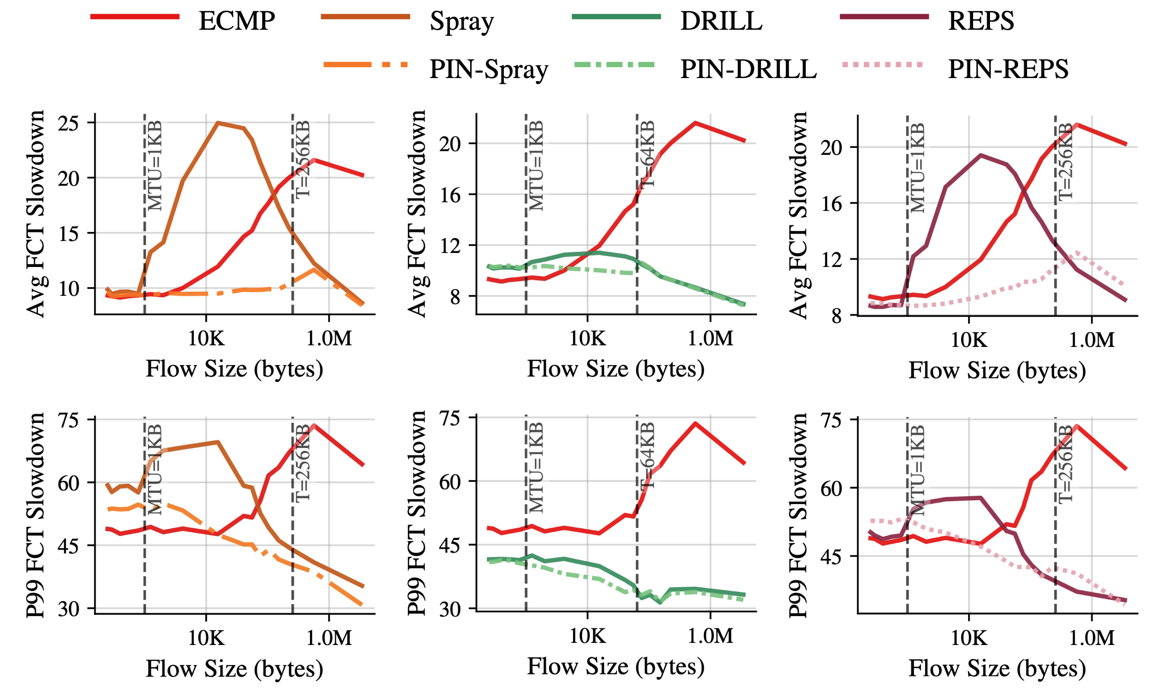
Results (80% load, Meta Hadoop)
PIN-Spray improves both avg and tail
Other spraying LBs have similar benefits
Better
Notes:
Let us first look at one representative result: Meta Hadoop at eighty percent load.
The top row of the plot is average slowdown, and the bottom row is the ninety-ninth percentile. On the left column, the solid brown line is the original Spray baseline, and the dashed orange line is PIN-Spray.
The original Spray curve has a clear slowdown bump for short multi-packet flows. PIN removes most of this bump. It improves both average and tail completion time in exactly the flow-size region we target.
For larger flows, the PIN-Spray curve rejoins the Spray baseline, because those flows continue using spraying.
The same pattern appears when PIN wraps DRILL and REPS. Therefore, the benefit does not depend on one particular load-balancing algorithm.
One thing worth noticing is that the REPS has a slightly too large threshold
TODO: remove CONGA, make better arrow longer
might be worth reiterating short flows need stability

Slide 10
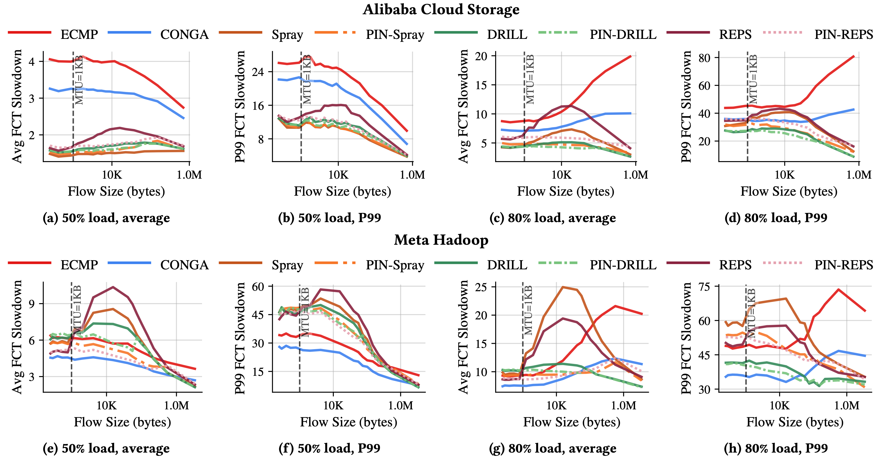
Results
Threshold: 64KB for DRILL, 256KB for Spray and REPS
Notes:
This slide summarises the broader results.
The top row is Alibaba Cloud Storage, and the bottom row is Meta Hadoop. For each workload, we show average and ninety-ninth-percentile slowdown at fifty and eighty percent load.
You do not need to inspect every curve. The important pattern is the comparison between each solid baseline and its corresponding PIN variant.
Across both workloads, both loads, and all three fine-grained baselines, PIN consistently reduces the slowdown of short multi-packet flows. The improvement is visible in both the mean and the tail.
At the same time, the curves converge again for large flows. This confirms that PIN preserves the baseline behaviour where path diversity matters most.
For these experiments, we use a 64-kilobyte threshold for DRILL, and a 256-kilobyte threshold for Spray and REPS

Slide 11
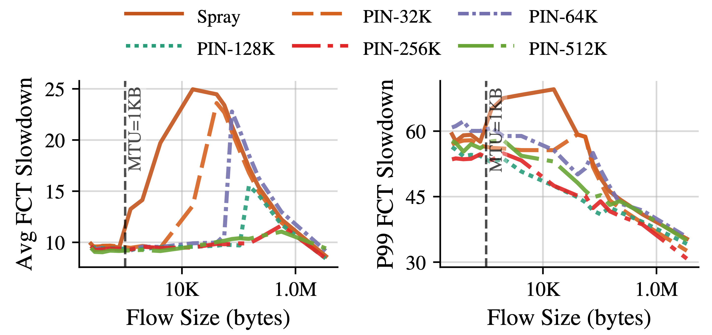
Threshold analysis
Too small: leave part of the gap unsolved
Too large: hurt global load balance like ECMP
Choose a middle value, e.g., 256KB
Better
Notes:
The threshold creates a straightforward trade-off.
If the threshold is too small, PIN protects only part of the vulnerable flow-size range, so some of the slowdown bump remains.
As we increase the threshold, more short multi-packet flows are pinned, and the bump becomes flatter.
However, if the threshold is too large, we remove too much traffic from fine-grained load balancing. This begins to hurt global load distribution, and performance moves back towards ECMP-like behaviour.
So the goal is not to pin as many flows as possible. The goal is to choose a moderate threshold that covers the vulnerable region while leaving large flows to the baseline.
In this example, 256 kilobytes provides a good balance.
---
Spray (Meta Hadoop, 80% load)
加一个结论：现在对于spray对于这种workload我们选定了256KB
可以加一个future work

Slide 12
Future work
PIN the tail of every flow instead of only short flows
AI workload
Dynamic threshold
Notes:
Before concluding, let me briefly discuss three directions for future work.
First, instead of pinning only flows that are short from the beginning, we could pin the tail of every flow. A large flow could use fine-grained multipathing for most of its bytes, and then switch to one stable path near the end. This may preserve the load-balancing benefit of spraying while reducing the risk that one of the final packets delays completion. However, this would require additional state and careful handling of the transition between the two modes.
Second, we would like to evaluate PIN with other workloads such as AI. Their communication patterns can be quite different from the storage and Hadoop workloads evaluated here, particularly because synchronisation may make tail latency even more important.
Finally, PIN currently uses a static, baseline-specific threshold. A natural extension is to adjust this threshold dynamically, based on signals such as the observed flow-size distribution, network load, or path conditions.

Slide 13
Q&A
Takeaway:
Fine-grained RDMA load balancing (e.g., spraying) is not uniformly beneficial
Short flows need path stability
PIN is a lightweight wrapper: pin the path for short flows, preserve baseline behavior for large flows
Notes:
With these future directions in mind, let me conclude with three takeaways.
Fine-grained RDMA load balancing is valuable, but it is not uniformly beneficial across flow sizes.
Large flows need path diversity to avoid persistent hotspots and use the available bandwidth. Short multi-packet flows face a different problem: spreading their packets across several transient path conditions increases the chance that one packet delays the entire operation.
PIN captures this distinction with a lightweight wrapper. It pins short flows to one path, while preserving the original load-balancing mechanism for large flows.
Across multiple workloads and baselines, PIN consistently improves both average and tail latency for short flows, while retaining the benefits of fine-grained multipathing for large flows.
Thank you. I’m happy to take questions.
Notes:
- LSTM for dynamic threshold
- backup slides / animation from Mark
- copy diagram on slide 2 to slide 1
- bittorrent?

